Slide 1
JAIME FÚSTER DE LA FUENTE ÁLVARO PENDÁS RECONDO MENTOR: PAUL HARVEY
Decentralized Controller Evolution Architecture Including an Integrated Marketplace
DIGITAL TWINS TEAM
FGAN BUILD-A-THON| 2022

Slide 2
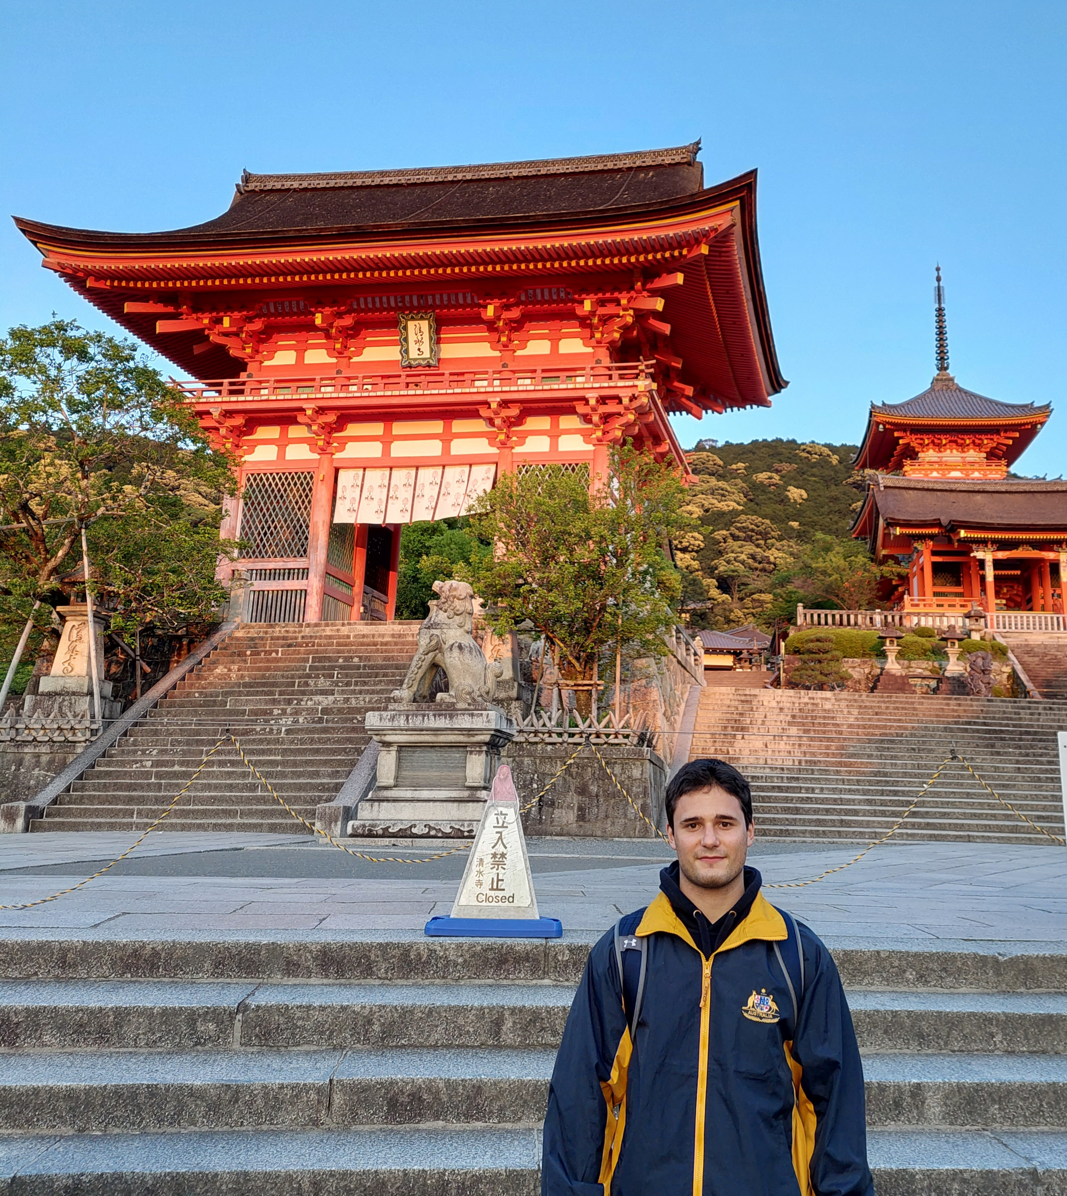
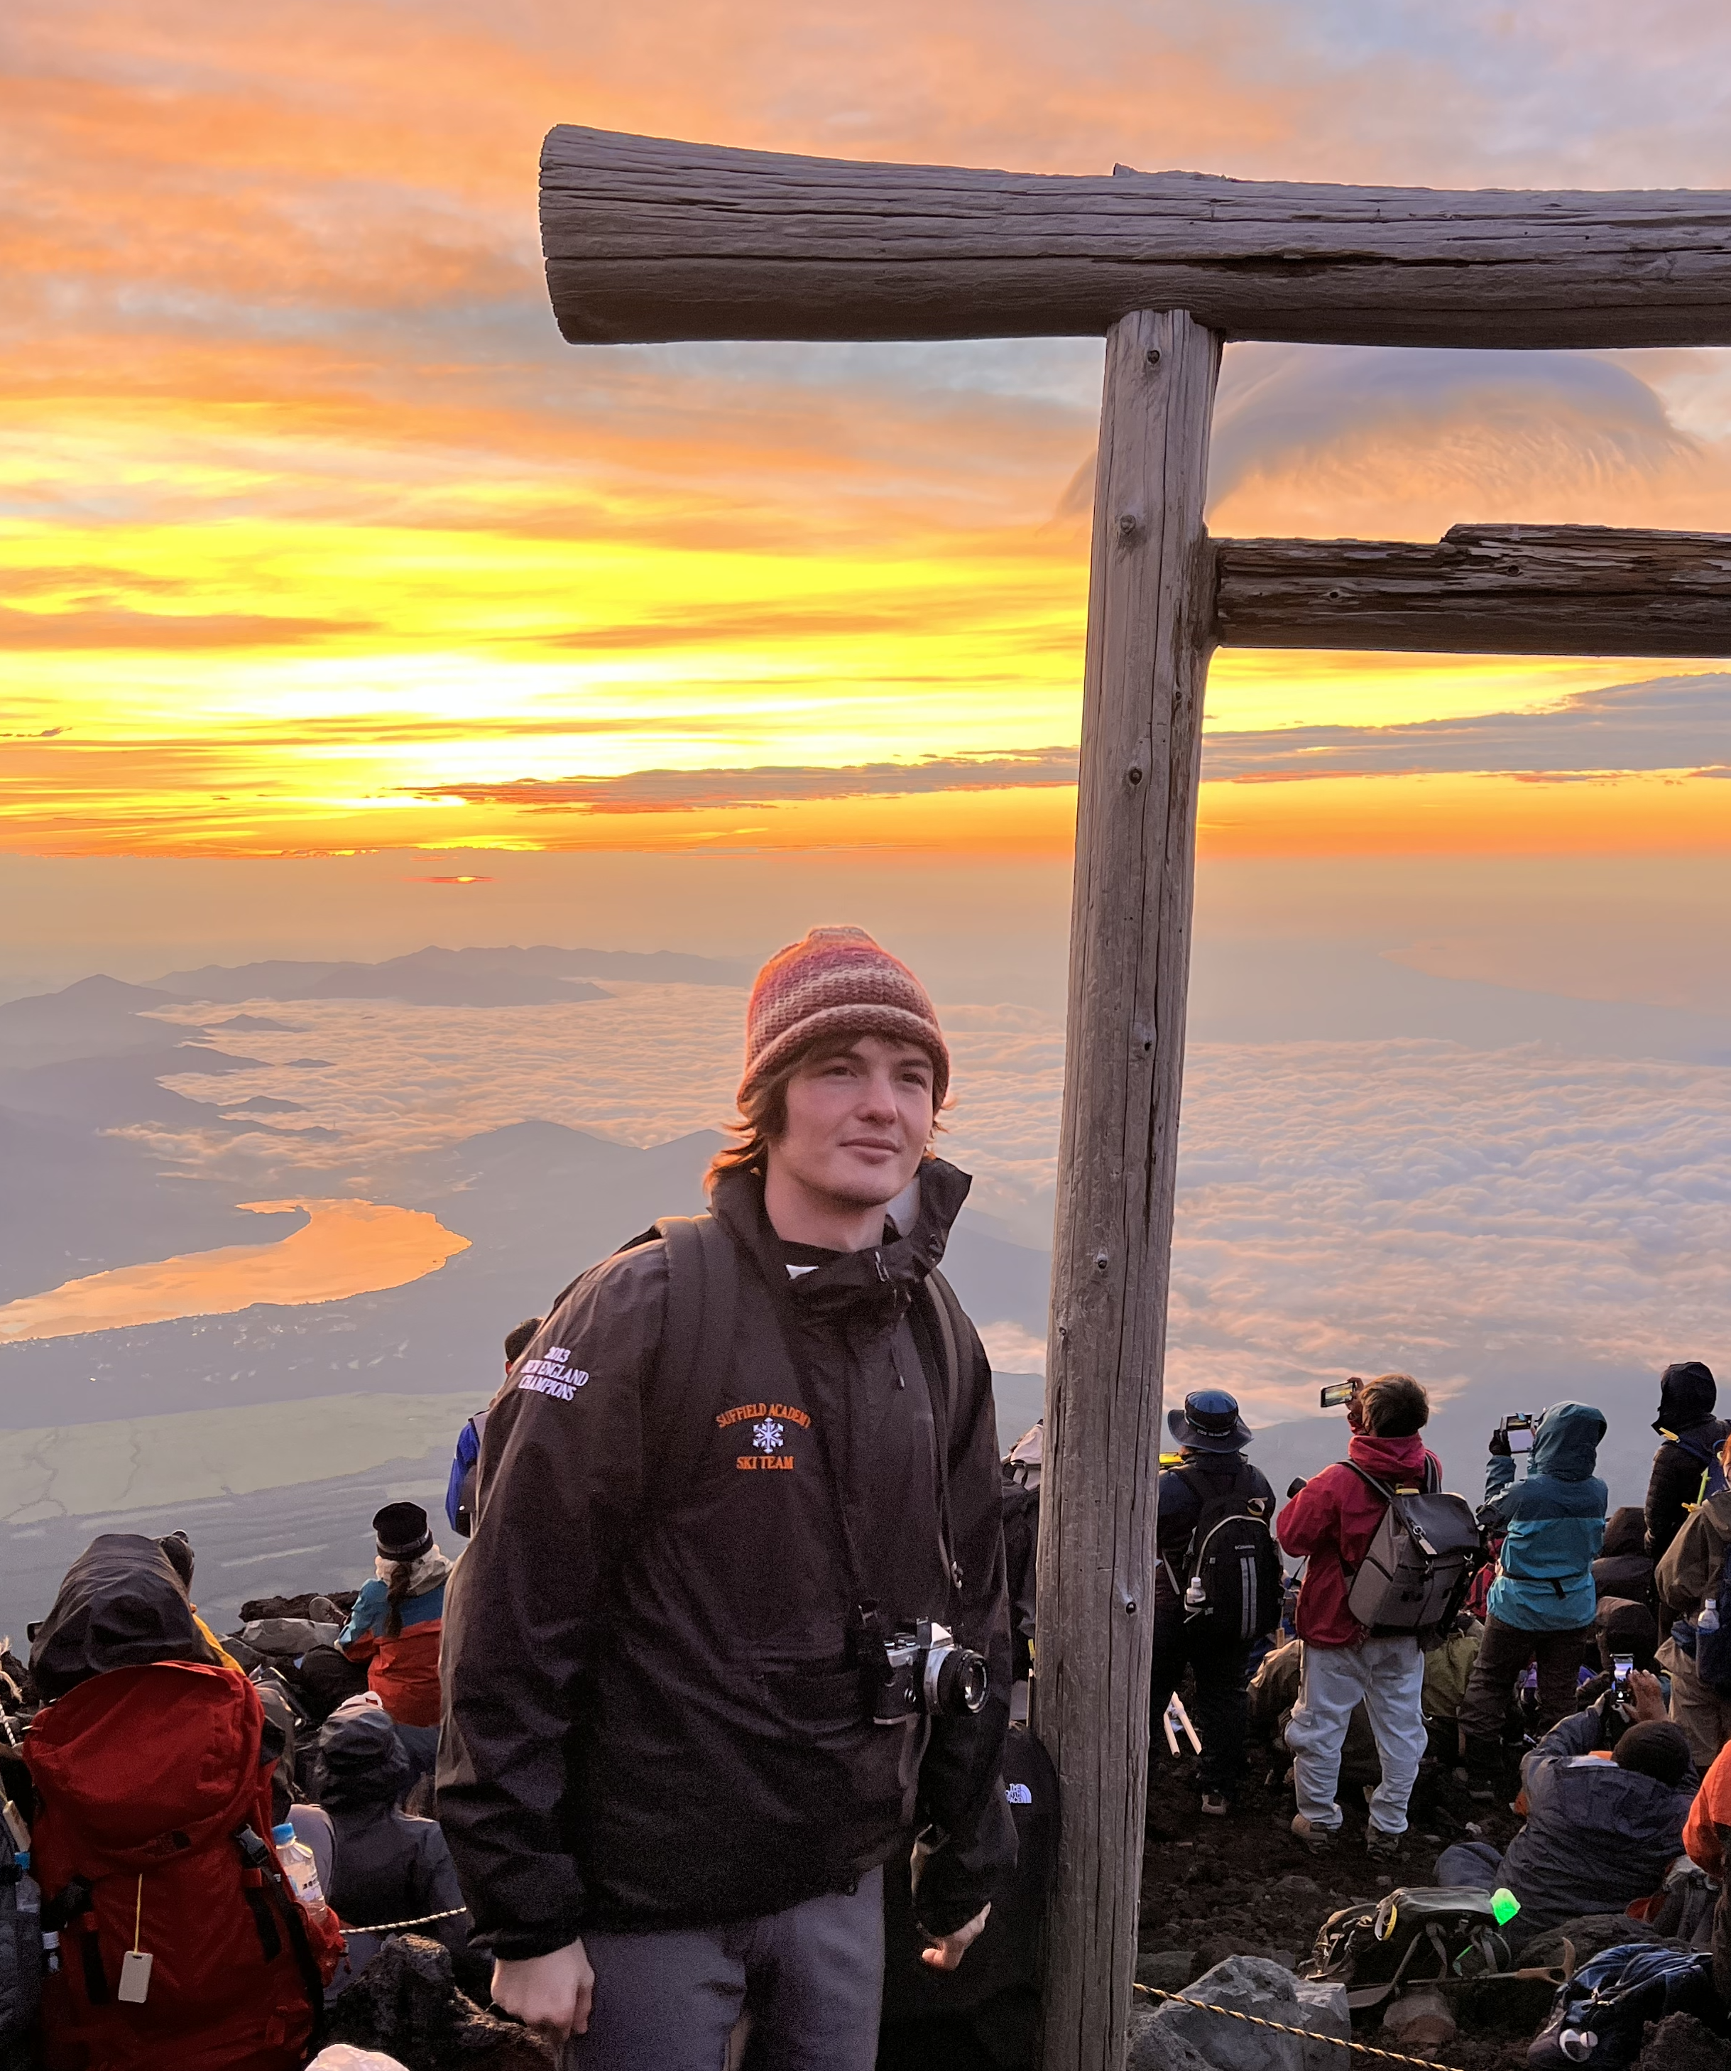
DIGITAL TWINS TEAM
JAIME FÚSTER DE LA FUENTE
ÁLVARO PENDÁS RECONDO​

Slide 3
CONTENTS
1 – INTRODUCTION
2 – PROBLEM STATEMENT
3 – PoC IMPLEMENTATION
4 – VIDEO DEMO
5 – CONCLUSIONS
6 – Q & A

Slide 4
0 – WHAT WE'VE DONE
End-to-end close-loop architecture for the secure and auditable evolution of controllers.
Focus on the decentralized architecture.
Future work
Add more complex modules and controllers
Protocol for notifying all nodes when a new module is uploaded
Implement an evolutionary algorithm
Implement more complex SCs for access control, updating, modifying files...
All these improvements can be made relying on the architecture developed for this PoC.

Slide 5
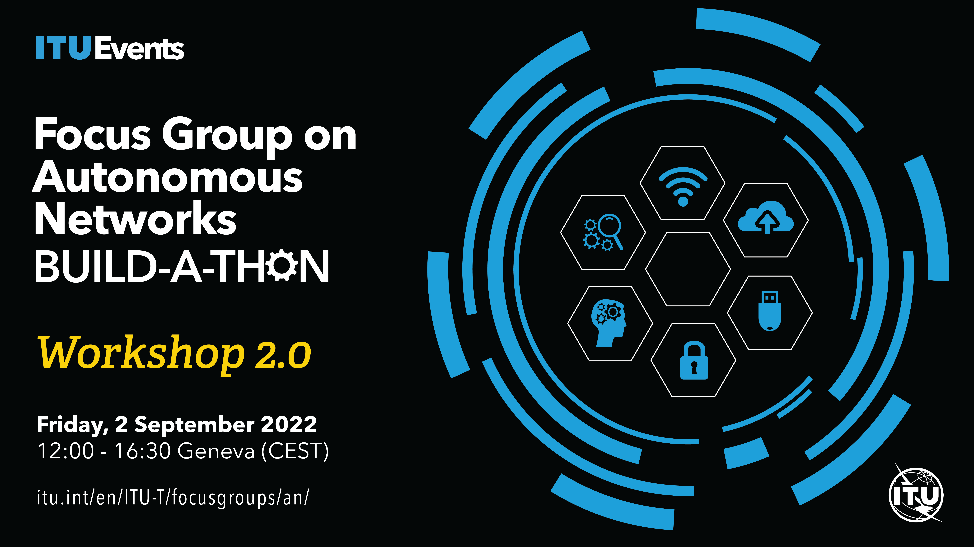
1 - INTRODUCTION
FGAN-I-239 describes the 2022 Build-a-Thon
PoC that is relevant for AN

Slide 6
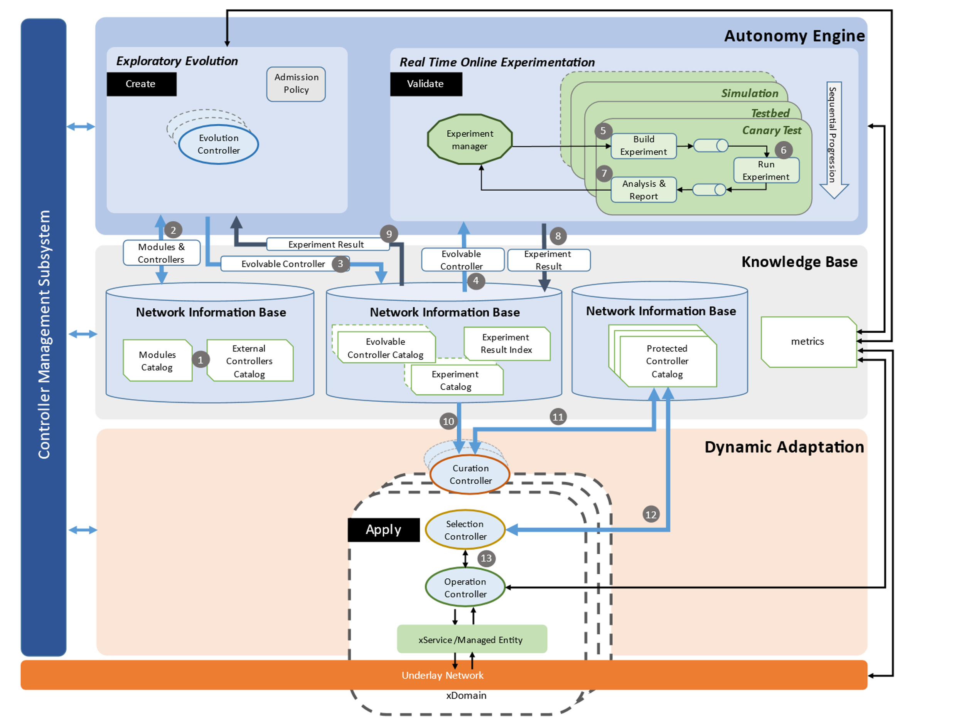
2 – PROBLEM STATEMENT
Architecture
proposed
in FGAN-I-198

Slide 7
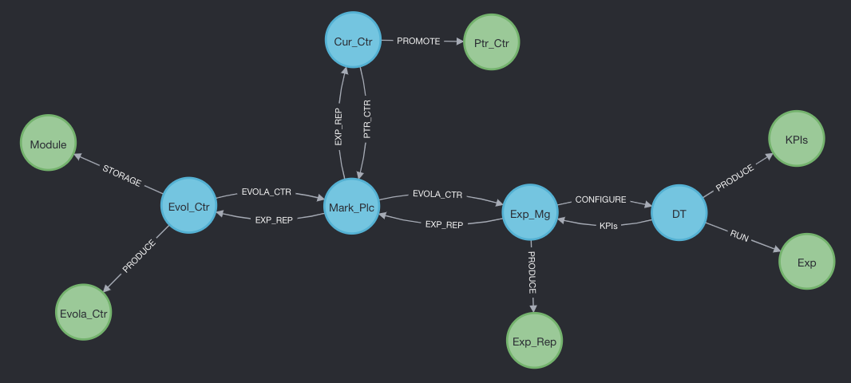
2 – PROBLEM STATEMENT
PoC Neo4J Graph

Slide 8
2 – PROBLEM STATEMENT
PoC architecture
6
7
1
2
3
6
5
4
ACTORS
ELEMENTS

Slide 9
2 – PROBLEM STATEMENT
Focus on the distributed architecture
Focus on the architecture
Simple Modules and Controllers
Add the concept of DT
"Dummy" DT for this PoC
ACTORS
ELEMENTS

Slide 10




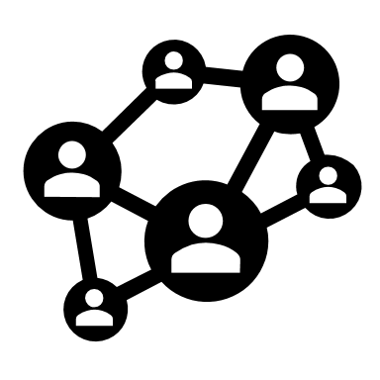




2 – PROBLEM STATEMENT
Secure and Traceable Evolution
How to store and access artifacts in a traceable and secure manner?
We need:
Decentralization
Distributed storage
Our solution:
Trust
Integrity
Auditability/Traceability
Fault tolerance
Scalability
Private, permissioned blockchain
SCs for uploading and modifying artifacts.
Distributed, decentralized filesystem.
Integrity ensured through CIDs (Content Identifier)
THE MARKETPLACE

Slide 11




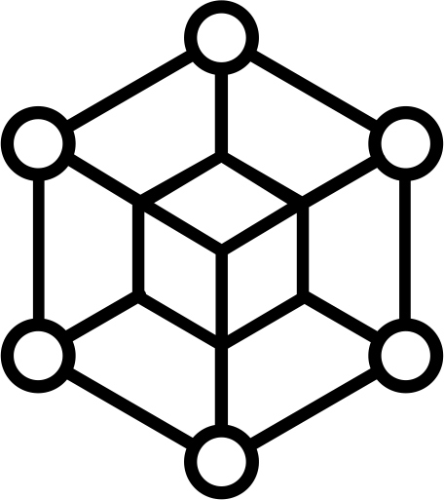
2 – PROBLEM STATEMENT
4
EVOL_CTR
MARK_PLC
EXP_MG
1
5
2
3
ETHEREUM

Slide 12
2 – PROBLEM STATEMENT
THE MARKETPLACE IS EVERYWHERE...

Slide 13
2 – PROBLEM STATEMENT
USE-CASES RELATED TO THIS PoC, FGAN-O-013
Use Case | Title
FG-AN-001 | Import and export of knowledge for autonomous network
FG-AN-002 | Configuring and driving simulators from autonomous components in the network
FG-AN-003 | Peer-in-loop
FG-AN-026 | Ev-as-a-service: Achieving zero touch evolution in a delegated autonomy case
FG-AN-0027 | Experimentation as a service: Digital twins as platforms for experimentation
FG-AN-0031 | OpenCN: An open repository of intents for controllers and modules
FG-AN-0039 | Towards openness in AN & FG-AN-usecase-0040, Awareness in AN

Slide 14
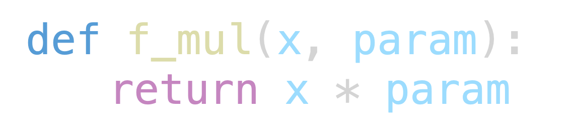

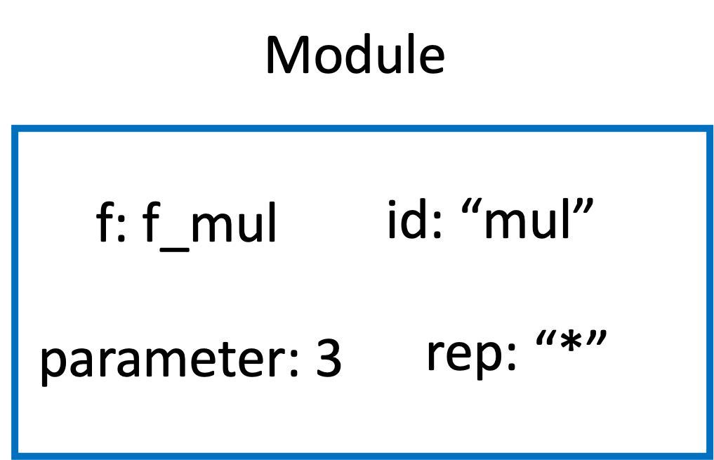
3 – IMPLEMENTATION
MODULES
Python Class Module
Attribute Python function (math operations)
Multiply *
Sum +
Subtract –
Pow ^

Slide 15
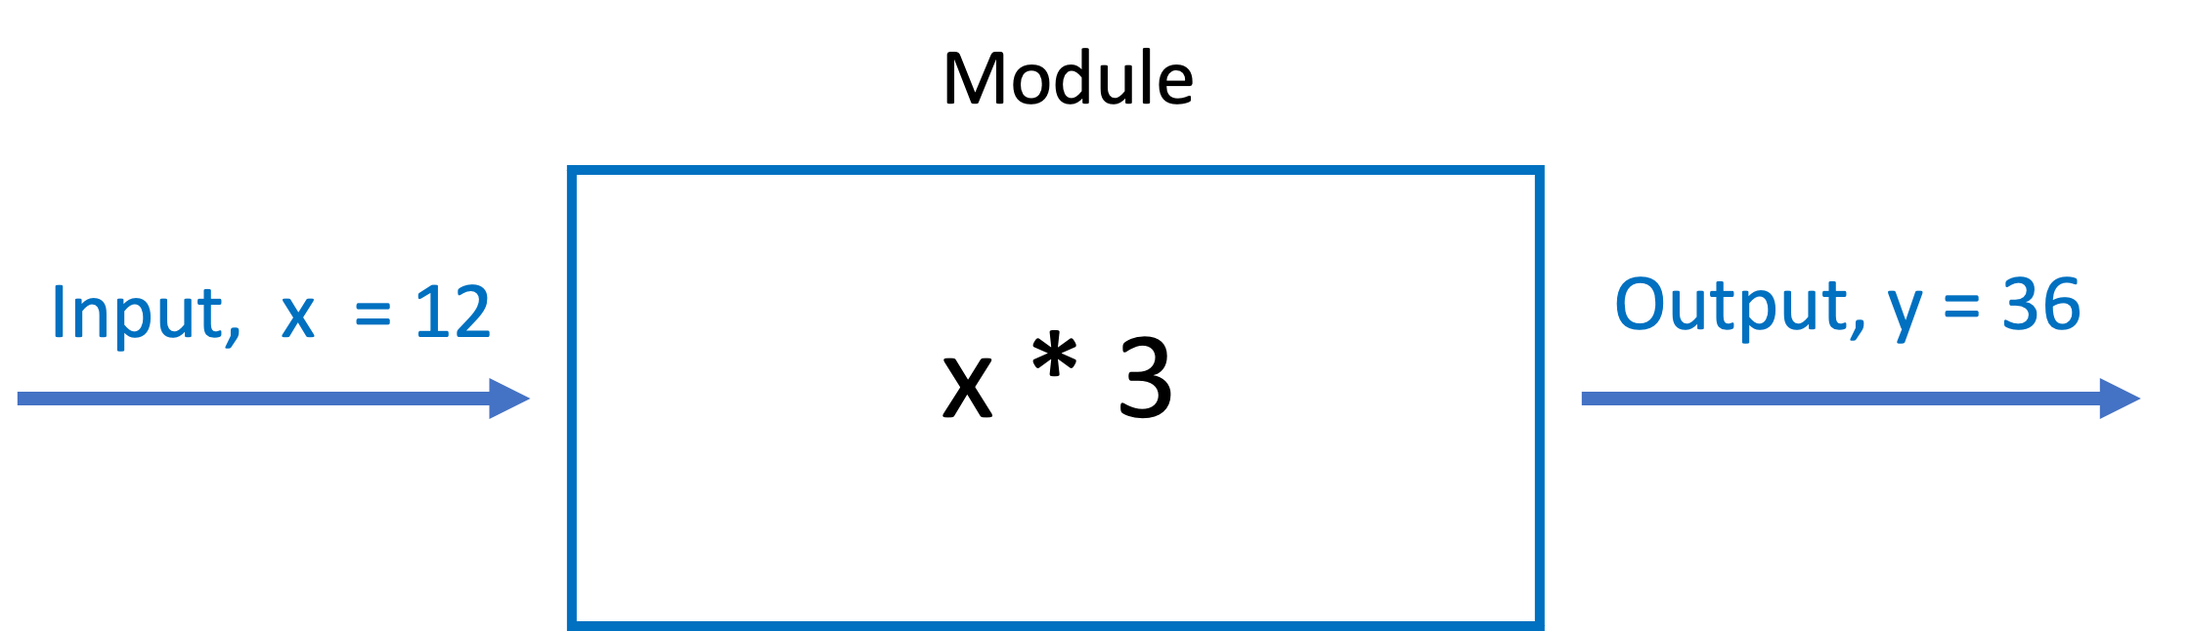
3 – IMPLEMENTATION
MODULES
Method execute

Slide 16
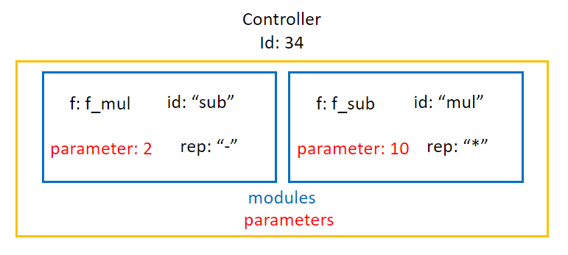
3 – IMPLEMENTATION
CONTROLLERS
Python Class Controller
Composed by a list of Modules a list of parameters

Slide 17
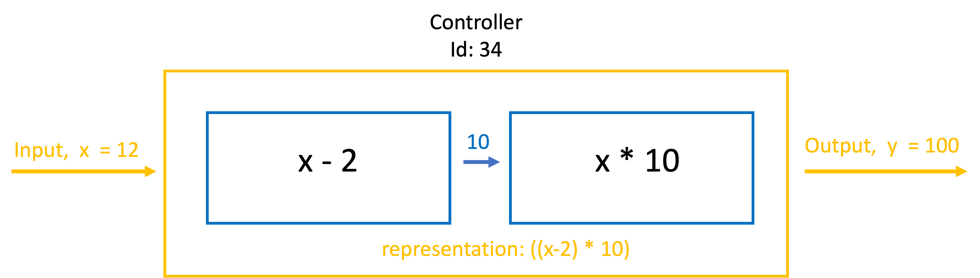
3 – IMPLEMENTATION
CONTROLLERS
Python Class Controller
Method Execute

Slide 18
3 – IMPLEMENTATION
TESTING AND EVOLUTION
Communication between nodes
JSON files via HTTP
JSON
JAVASCRIPT
PYTHON
FLASK & GUNICORN

Slide 19
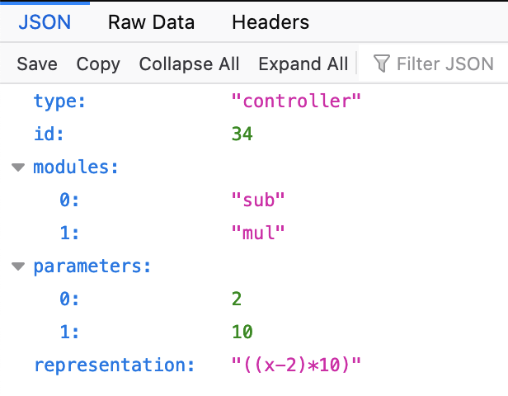
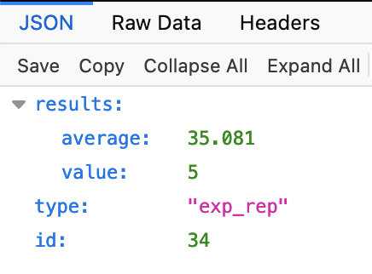
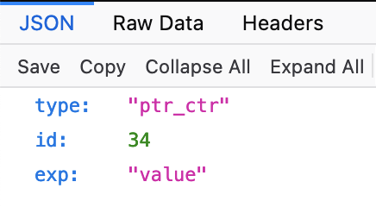
3 – IMPLEMENTATION
JSON REPRESENTATIONS IN THE MARKETPLACE
Controller
Experiment Report
Protected Controller

Slide 20
3 – IMPLEMENTATION

Slide 21
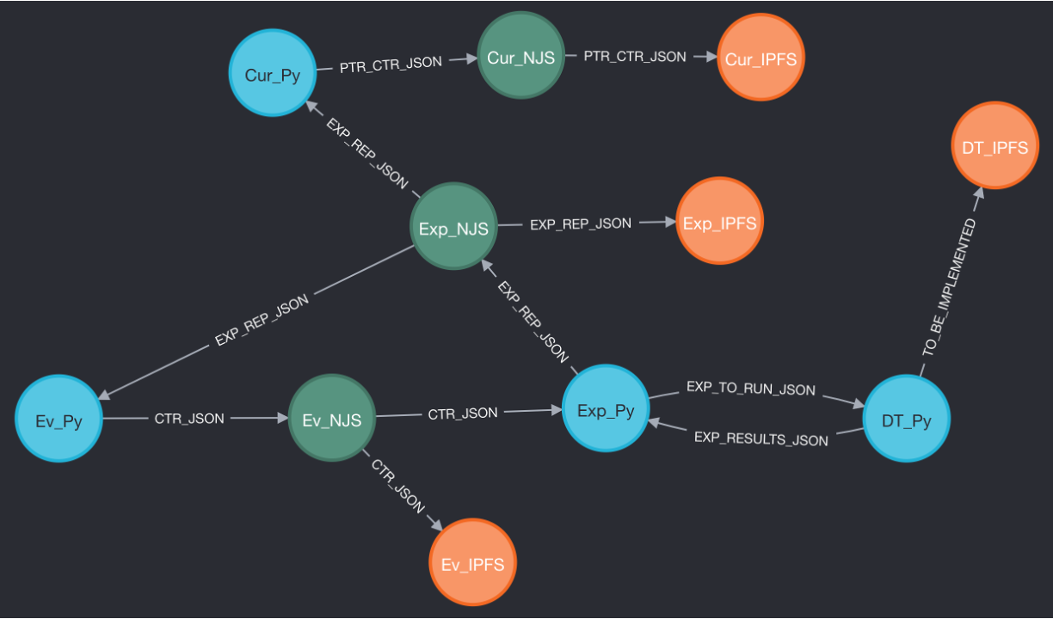
3 – IMPLEMENTATION
PYTHON
BLOCKCHAIN/NODE.JS
IPFS

Slide 22
3 – IMPLEMENTATION
CUR_CTR
DT
EXP_MG
EVOL_CTR

Slide 23
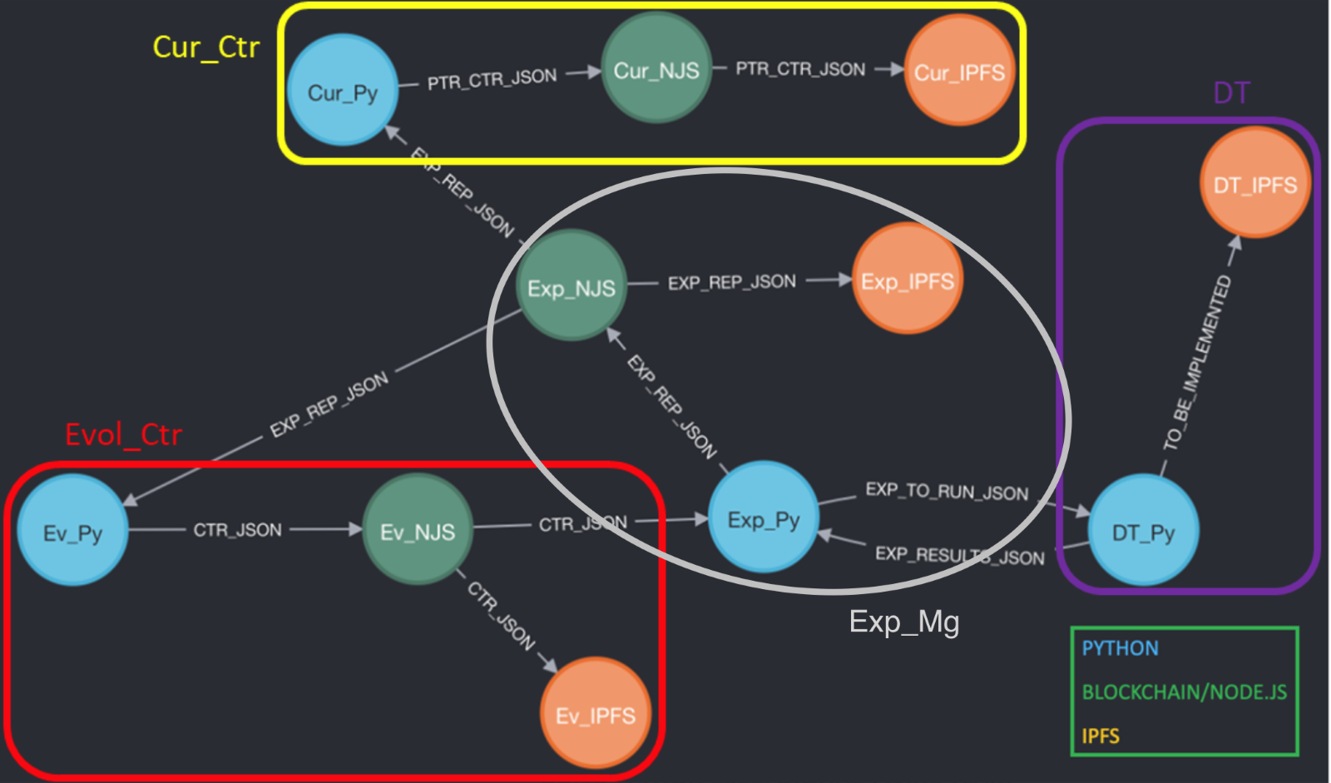
3 – IMPLEMENTATION

Slide 24
3 – IMPLEMENTATION
172.16.239.41
3000
172.16.239.42
5001
172.16.239.32
172.16.239.43
6003
172.16.239.23
172.16.239.22
5001
5001
3000
172.16.239.11
6004
3000
6001
6001
6002
172.16.239.13
172.16.239.21
172.16.239.31
5001
IP ADDRESS
PORT
172.16.239.12

Slide 25
3 – IMPLEMENTATION
172.16.239.32
4000, 5001, 8080
8092 : 8080
172.16.239.42
4000, 5001, 8080
IPFS NETWORK
8093 : 8080
Docker container port
Local machine mapped port
172.16.239.22
4000, 5001, 8080
8091 : 8080
172.16.239.12
4000, 5001, 8080
8090 : 8080

Slide 26
3 – IMPLEMENTATION
BLOCKCHAIN ETHEREUM NETWORK
172.16.239.43:8545
172.16.239.23:8545
172.16.239.13:8545

Slide 27
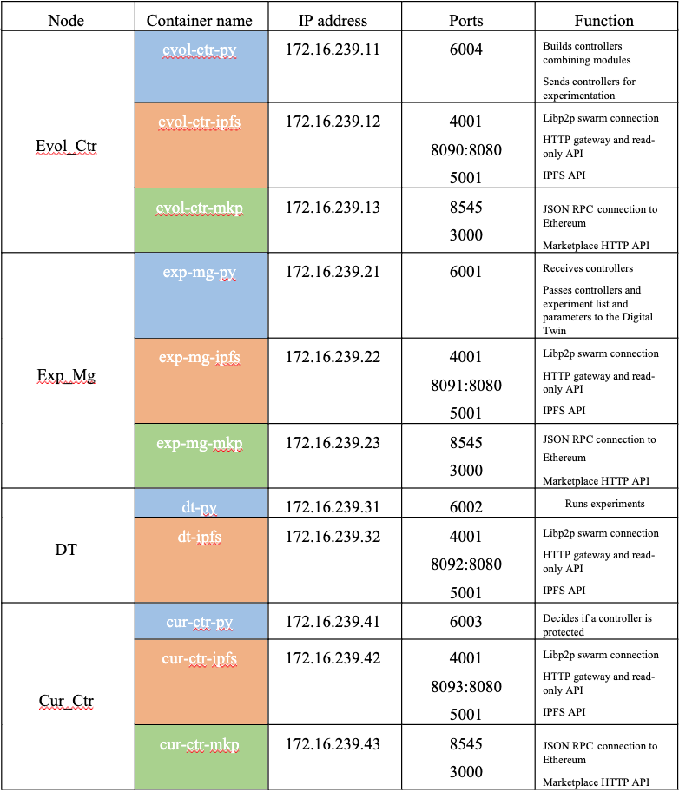
3 – IMPLEMENTATION

Slide 28
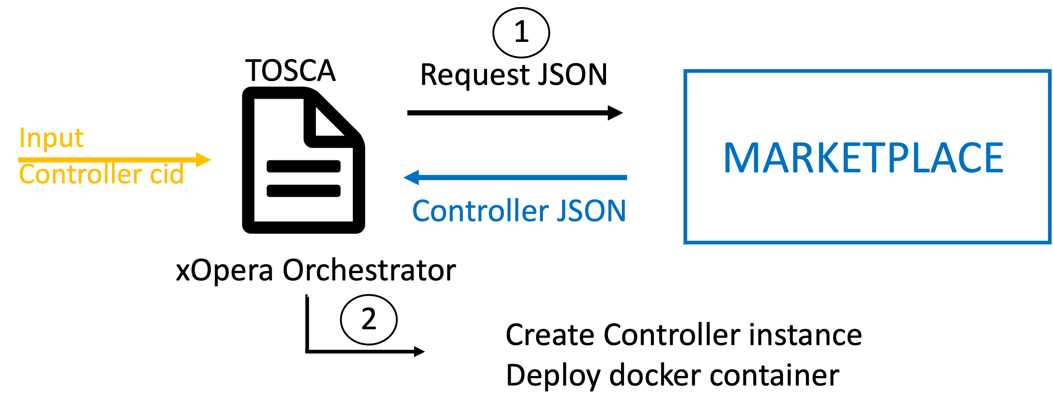
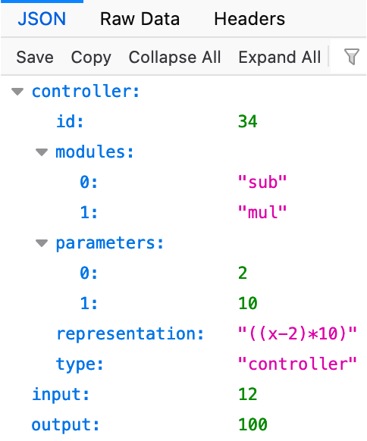
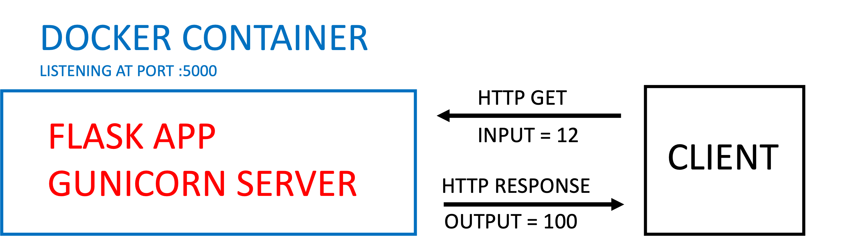
3 – IMPLEMENTATION
CONTROLLER DEPLOYMENT

Slide 29
4 – VIDEO DEMO
Overview
Deployment of the docker network and starting the code.
Show logs of different actors and the outputs from the marketplace.
Demo of controller deployment with TOSCA.
Show Neo4j code and graphs

Slide 30
5 – CONCLUSIONS
End-to-end close-loop architecture for the secure and auditable evolution of controllers.
Focus on the decentralized architecture.
Future work
Add more complex modules and controllers
Protocol for notifying all nodes when a new module is uploaded
Implement an evolutionary algorithm
Implement more complex SCs for access control, updating, modifying files...
All these improvements can be made relying on the architecture developed for this PoC.

Slide 31
5 – CONCLUSIONS
GITHUB:
https://github.com/FGAN-Digital-Twins/docker-network.git

Slide 32
6 – Q & A
Q & A

